Slide 1
DYNAMIC PROGRAMMING (DP)
Introduction:
Dynamic Programming is a special kind of Optimization technique often used for making a sequence of interrelated decisions.
It provides a systematic procedure for determining the combinations of decisions that optimizes the overall effectiveness.
It is used to solve a multi-stage decision problem where decisions have to be made at successive stages.
This technique is very much useful whenever if an optimization model has a large number of decision variables.

Slide 2
The terminologies used in the Dynamic Programming problem are :
Stage: The point at which a decision is made is known as a stage. The end of a stage marks the beginning of the immediate succeeding stage. For instance, in the salesmen allocation problem, each territory represents a stage; in the shortest route problem, each city represents a stage.
State: The variable that links two stages in a multistage decision problem is called a state variable. At any stage, the values that state variables can take describe the status of the problem. These values are referred to as states. For example, in the shortest route problem, a city is referred to as state variable.
Alternative : In a given stage, there may be more than one choice of carrying out a task. Each choice is known as an alternative
Policy : A particular sequence of alternatives (course of action) adopted by the decision-maker in a multi-stage decision problem is called a policy.
Optimal policy: A policy which optimizes the value of an objective function is called an optimal policy.

Slide 3
Return function : At each stage, a decision is made which can affect the state of the system at the next stage and help in arriving at the optimal solution at the current stage. Every decision has its merit which can be represented in an algebraic equation form. This equation is called a return function.
Recursive Equation(Functional Equation): It connecting the optimal decision function for the n-stage problem with the optimal decision function for the (n-1) stage sub problem.
In Forward recursion, the computations proceed from left to right (from stage 1 to stage n).
In Backward recursion, the computations proceed from right to left (from stage n to stage 1).
Both the forward and backward recursions yield the same solution.

Slide 4
Principle Of Optimality
Dynamic Programming technique was developed by Richard Bellman in 1957. This model is derived based on the Bellman’s principle. which states that, ‘An optimal policy has the property that whatever the initial state and the initial decisions are, the remaining decisions must constitute an optimal policy which regards to the state resulting from the first decision’.
That is, Future decisions for the remaining stages will constitute an Optimal policy regardless of the policy adopted in previous stages

Slide 5
Deterministic DP determines the optimum solution of n number of multivariable problem by decomposing it into n stages with each stage constituting a single-variable sub problem. These sub problems are then solved sequentially until the original problem is finally solved. It is a systematic, complete enumeration technique. It involves problems where the problem conditions at each stage, that is, state variable are known with certainty.
Solution Procedure for a multi stage decision problem using the DP approach
Step1 : Define the stages of the problem, the alternatives at each stage,
the states for each stage and the recursive equation
Step2: Solve the recursive equation according as the system is continuous or discrete. In the continuous case, the optimal decisions at each stage are obtained by the calculus method of optimization. In the discrete case, a tabular computational scheme is followed. The number of rows in each table is equal to the number of corresponding feasible state values and the number of columns is equal to the number of possible decisions.

Slide 6
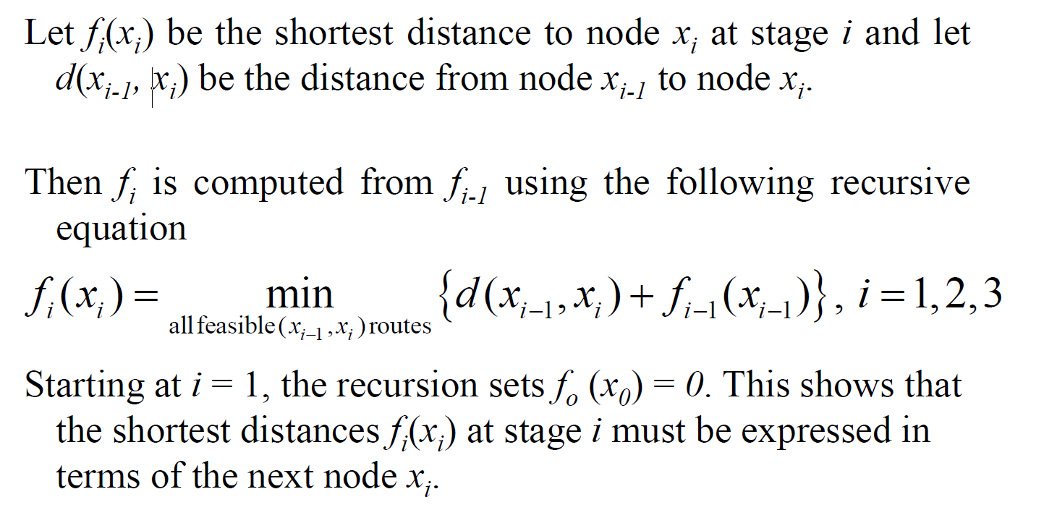
Forward Recursive Equation for the Shortest Route Problem
Shortest Route Problem(Stage-Coach Problem): It is a problem of finding the shortest
Distance and the corresponding path from a given source node to a given destination node in a given distance network.
Let $x_{i }$ be the state of the system at stage i, i=1,2,3,…n

Slide 7
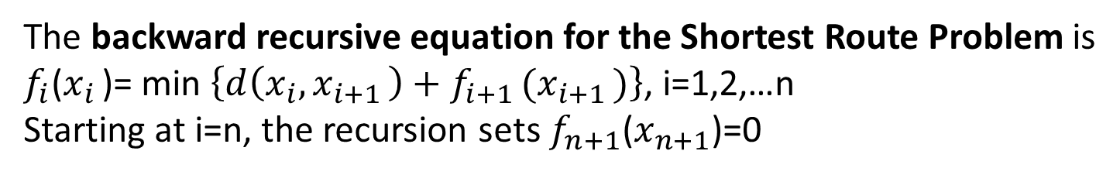
The backward recursive equation for the Shortest Route Problem is
$f_{i}$($x_{i }$)= min $\left\{d\left(x_{i}, x_{i+1 }\right)+f_{i+1 }(x_{i+1 })\right\}$, i=1,2,…n
Starting at i=n, the recursion sets $f_{n+1}$($x_{n+1}$)=0

Slide 8
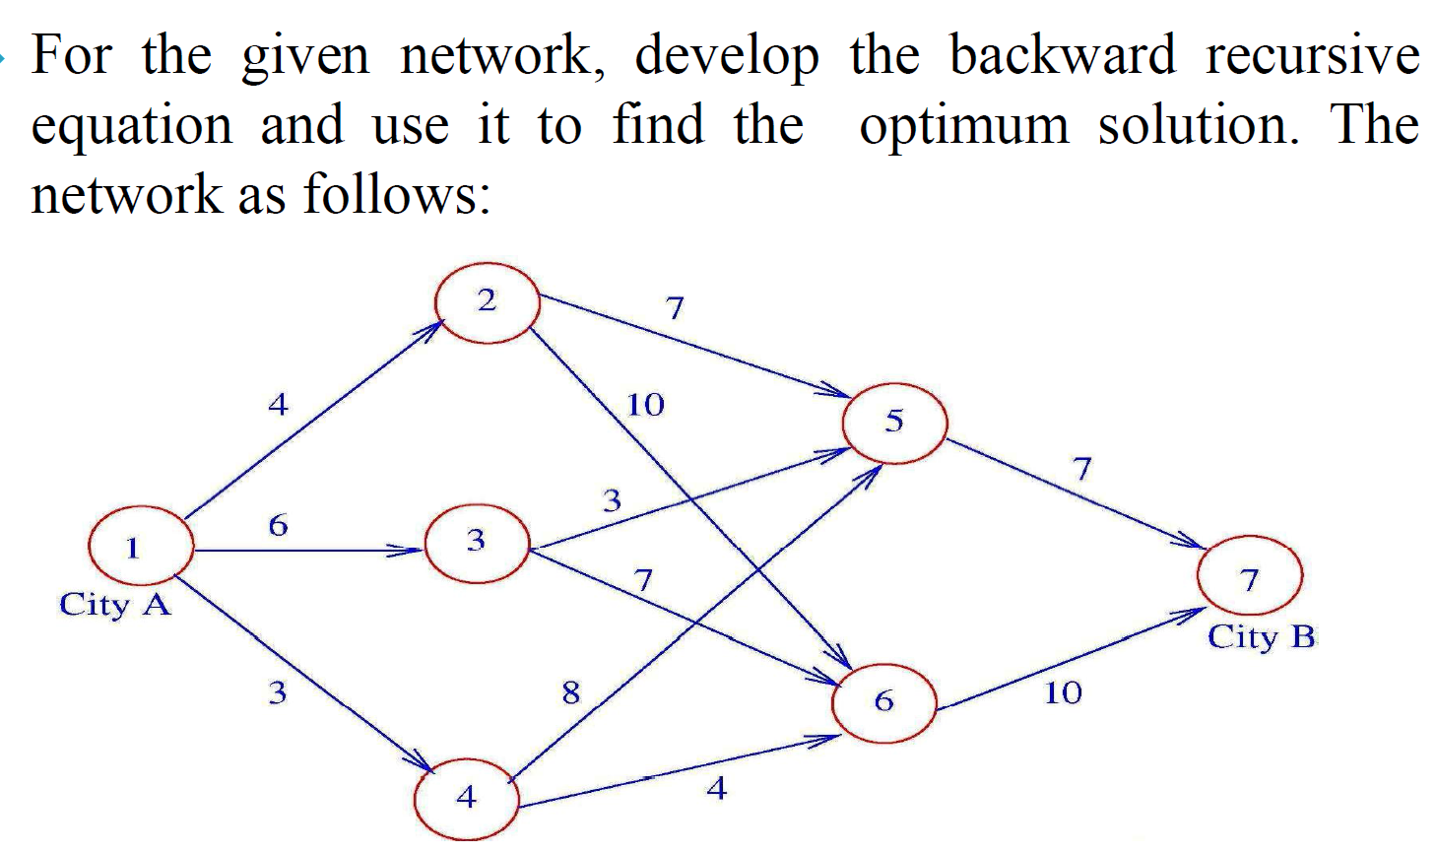
Example :(Shortest Route Problem)

Slide 9
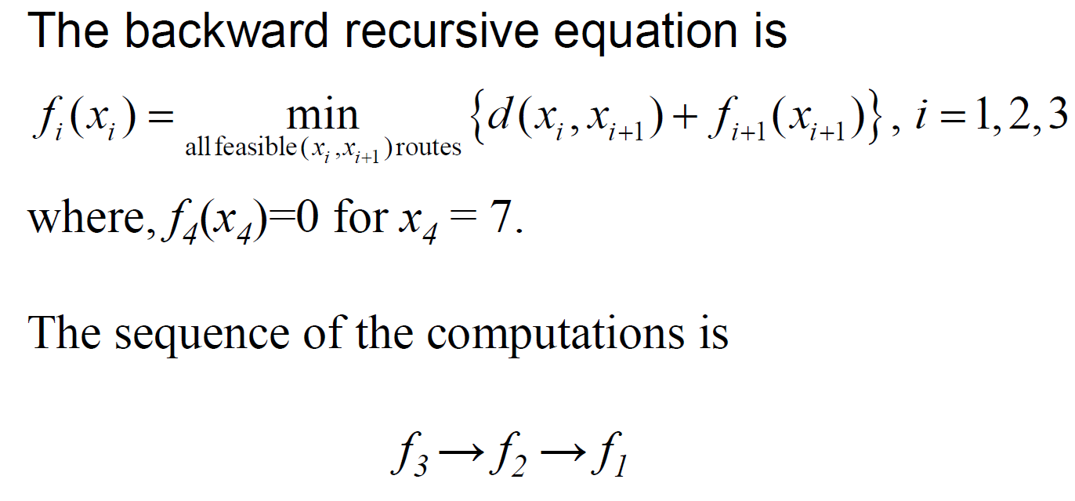
To solve the problem by dynamic programming (DP), we first decompose it into stages as delineated by the vertical dashed lines. We carry out the computations for each stage separately.

Slide 10
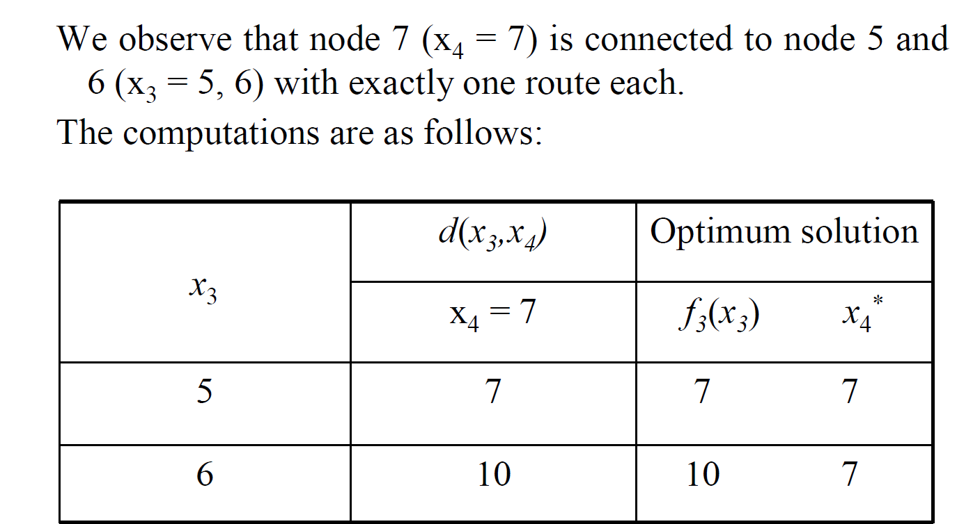
Stage 3

Slide 11
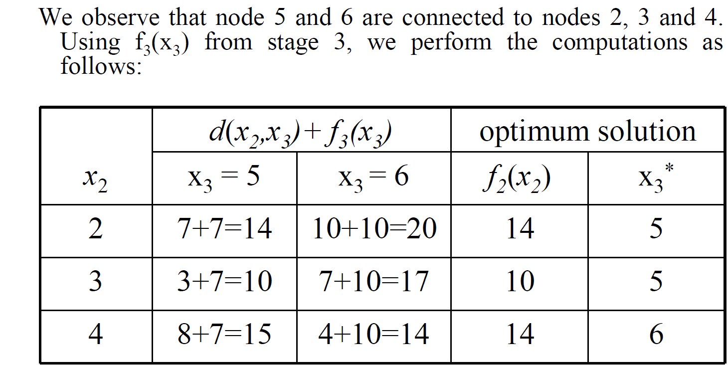
Stage 2

Slide 12
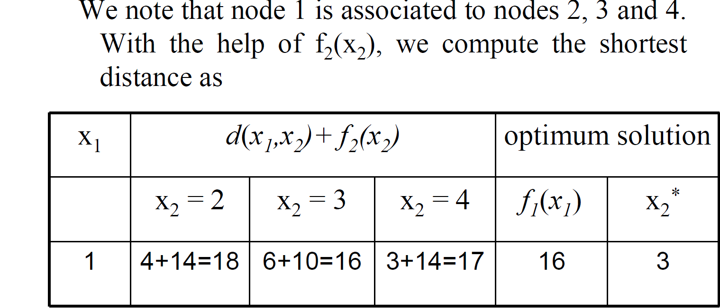
Stage 1
Therefore, the optimum solution at stage 1 is 16, i.e., the shortest distance between nodes 1 and 7 is 16 km.
The shortest path is 1 → 3 → 5 → 7.

Slide 13
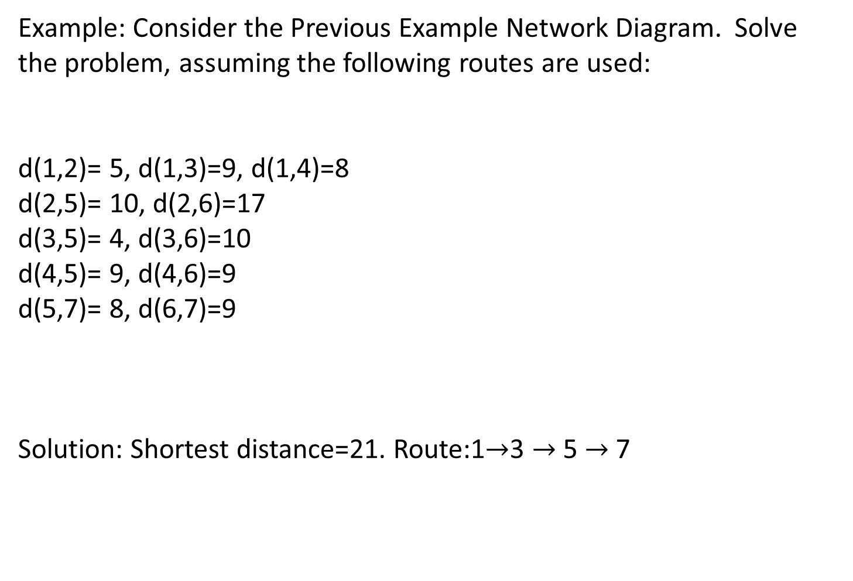
Example: Consider the Previous Example Network Diagram. Solve the problem, assuming the following routes are used:
d(1,2)= 5, d(1,3)=9, d(1,4)=8
d(2,5)= 10, d(2,6)=17
d(3,5)= 4, d(3,6)=10
d(4,5)= 9, d(4,6)=9
d(5,7)= 8, d(6,7)=9
Solution: Shortest distance=21. Route:1$→$3 $→$5 $→$7

Slide 14
Knapsack/Fly-Away/Cargo-Loading Problem
The knapsack problem deals with the situation in which a soldier (or a hiker) must decide on the most valuable items to carry in a backpack. (Army)
Also known in the literature as
The fly-away kit problem, in which a jet pilot must determine the most valuable (emergency) items to take aboard a jet. (Air force)
The cargo-loading problem, in which a vessel with a limited volume or weight capacity is loaded with the most valuable cargo items. (Navy)

Slide 15
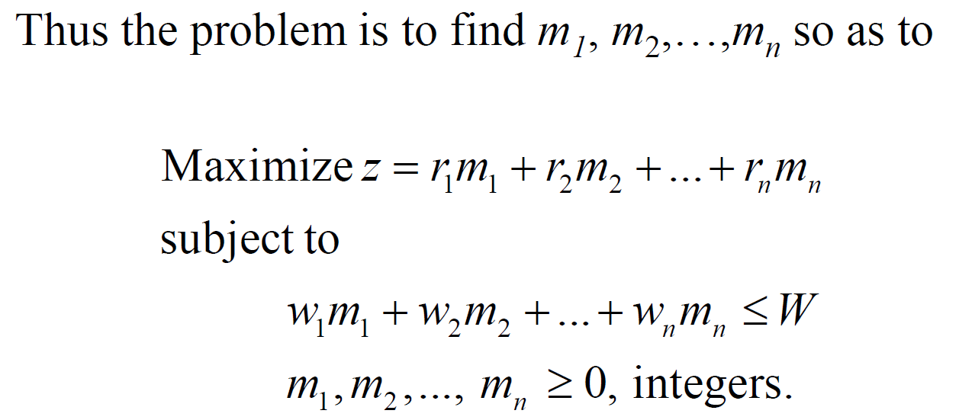
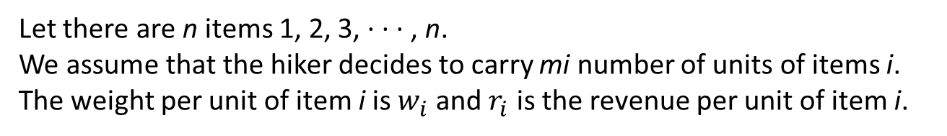
Mathematical Formulation of Cargo-loading Problem
Let there are n items 1, 2, 3, · · · , n.
We assume that the hiker decides to carry mi number of units of items i.
The weight per unit of item i is $w_{i}$ and $r_{i}$ is the revenue per unit of item i.
The hiker can carry a weight of at most W.

Slide 16
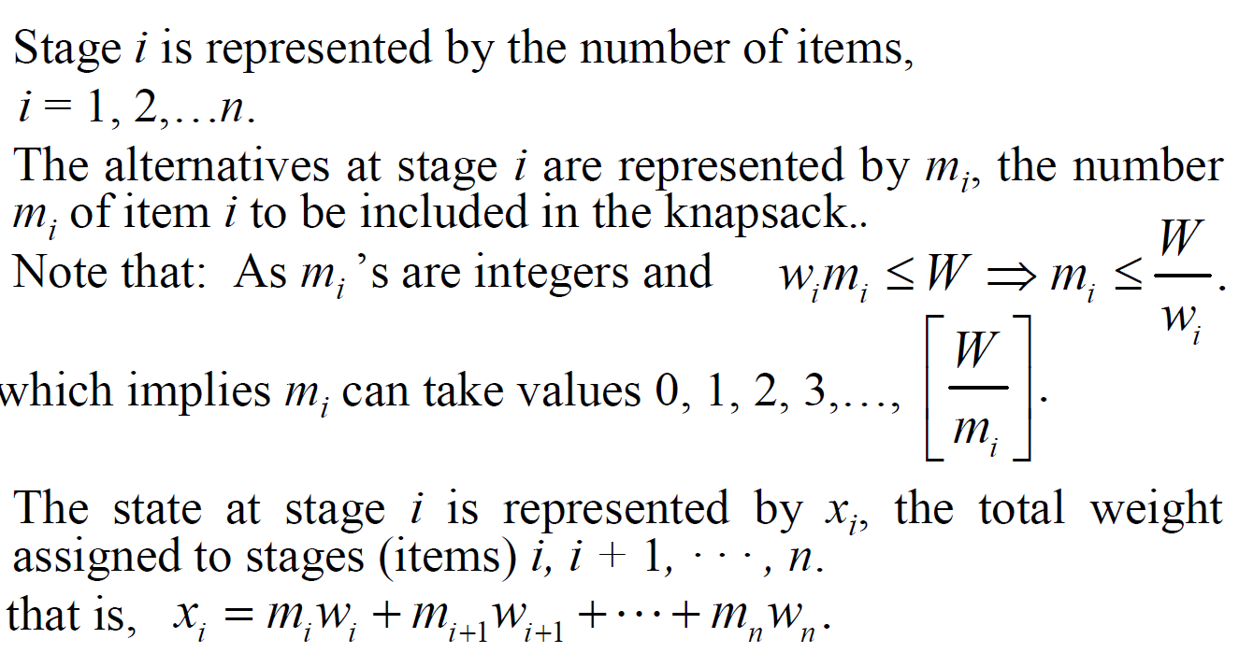
Stage, Alternative and State of the Problem

Slide 17
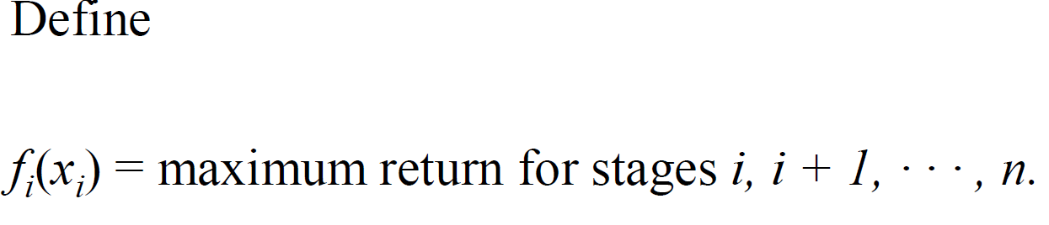
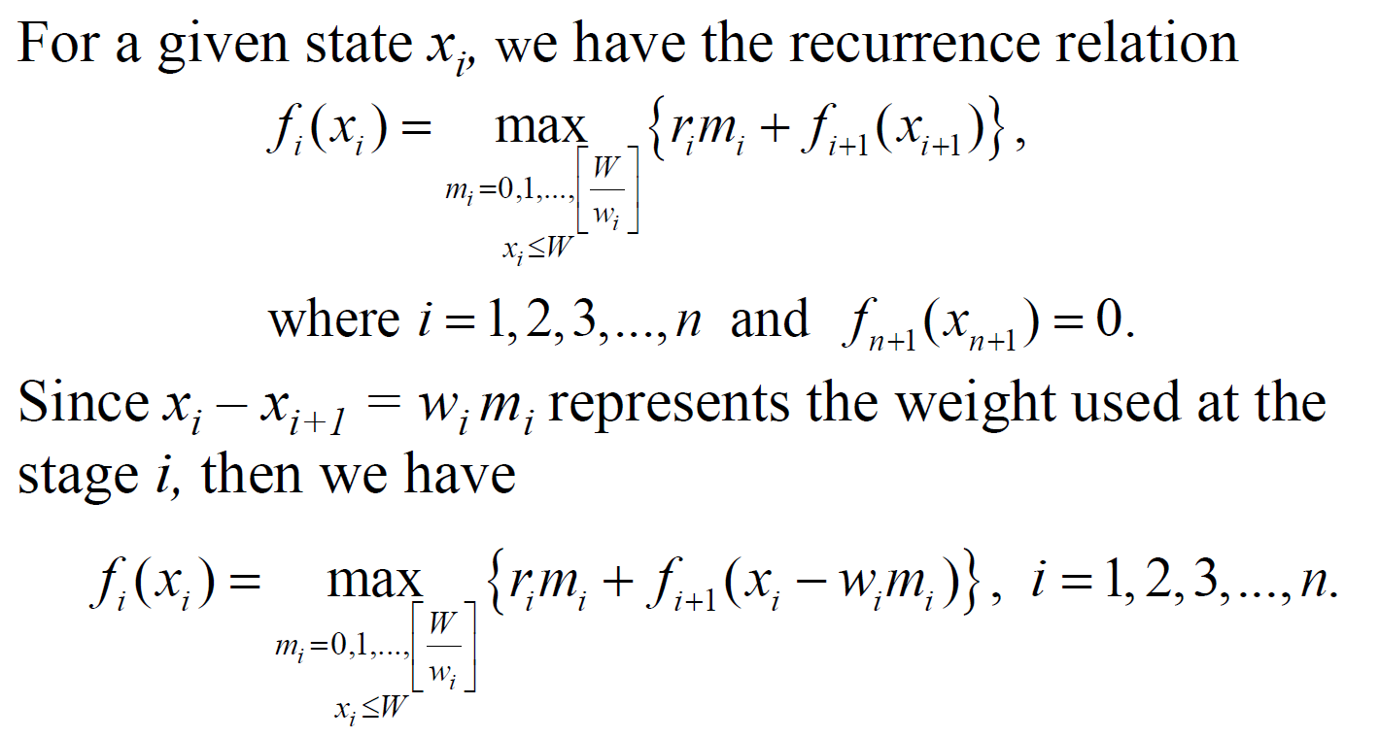
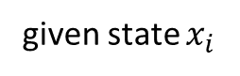
The Backward recursive equation for this problem is
given state $x_{i}$

Slide 18
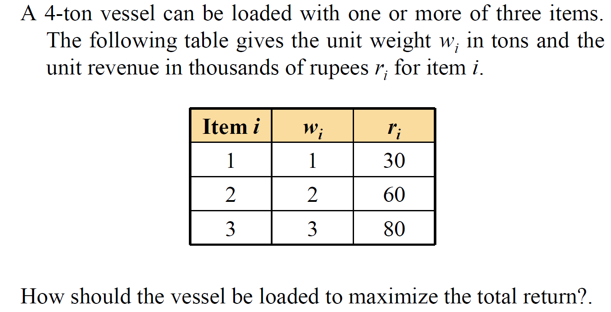
Example :

Slide 19
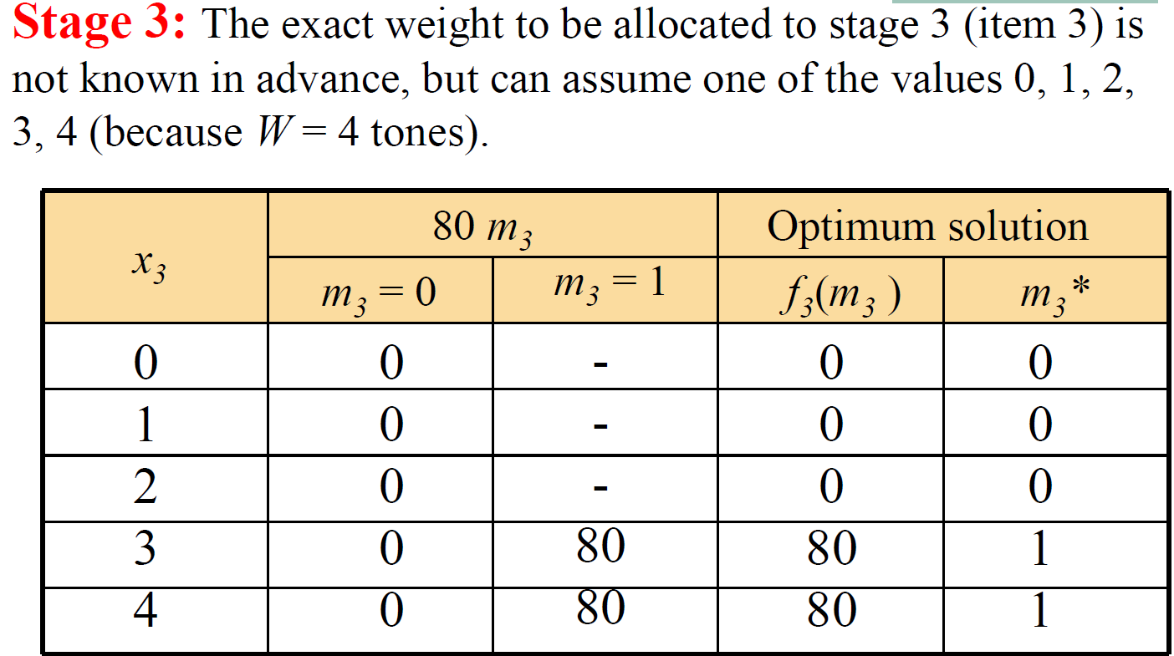

Slide 20
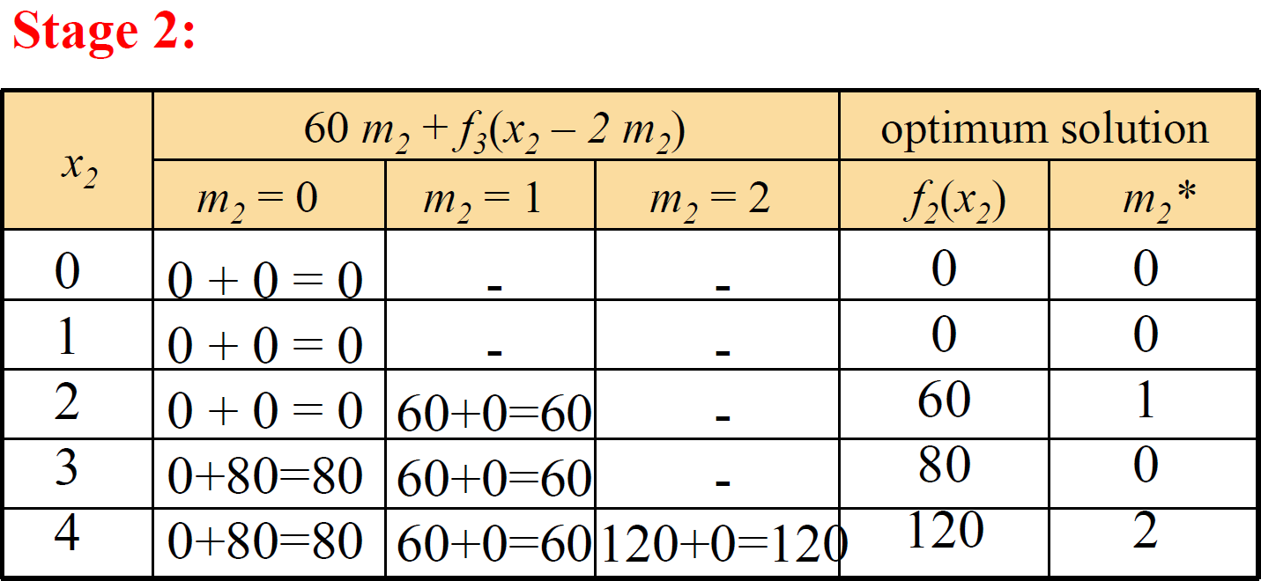

Slide 21
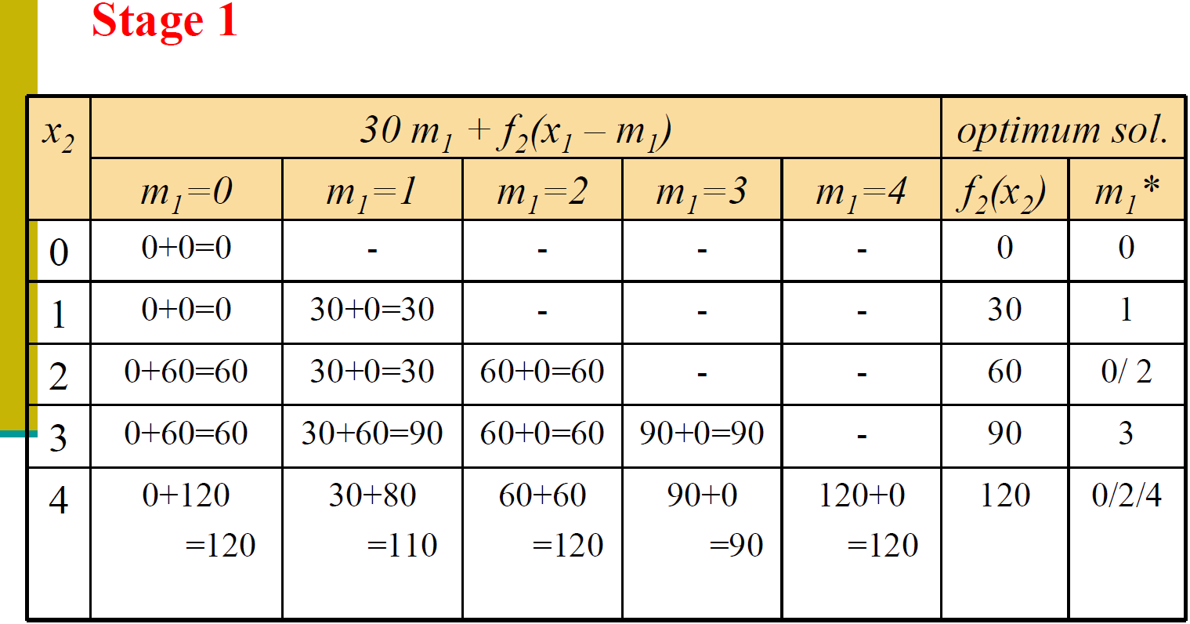

Slide 22
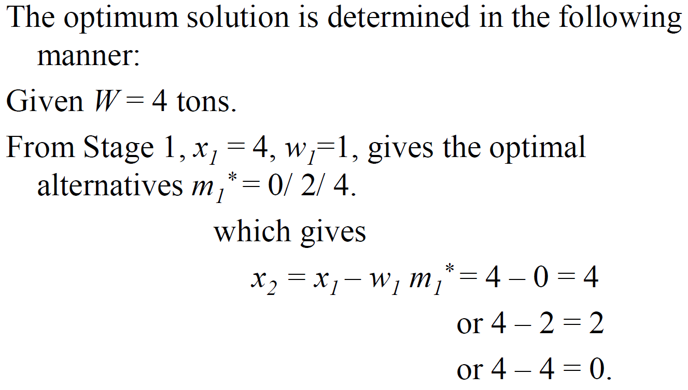

Slide 23
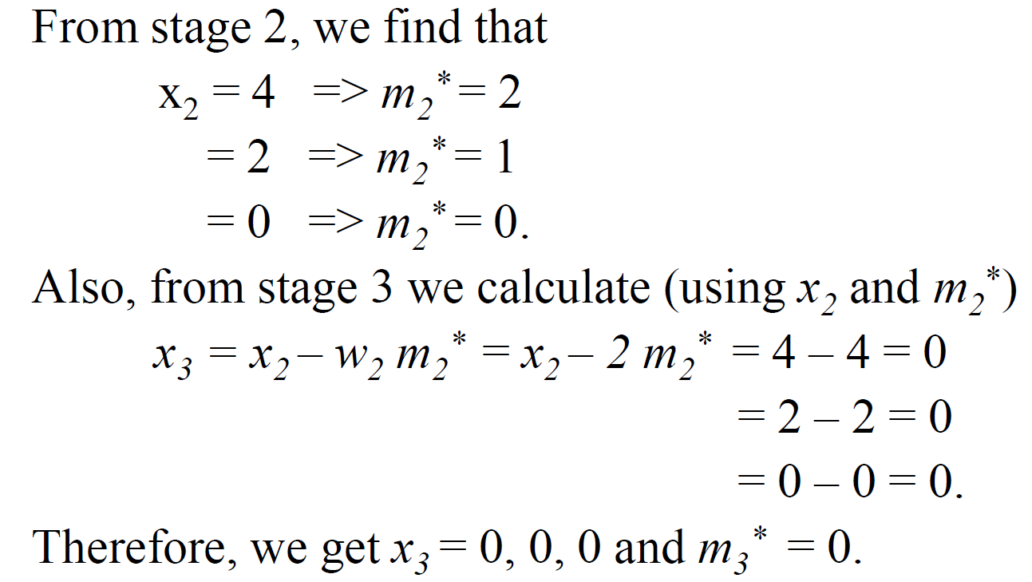
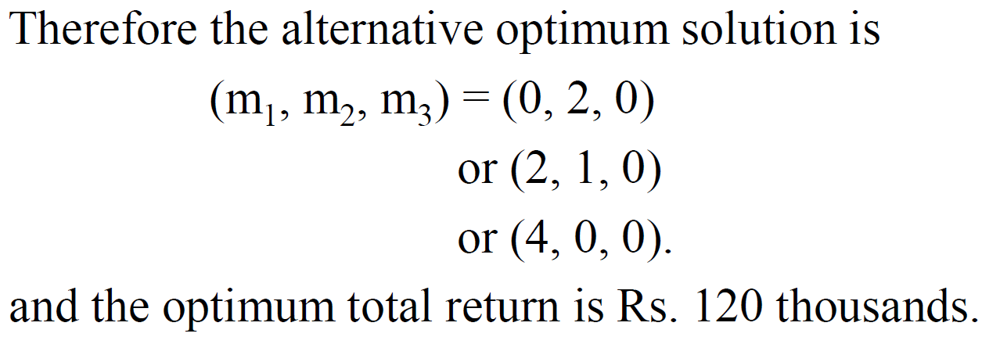

Slide 24
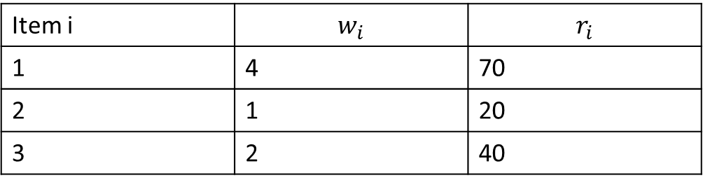
Example :
Solve the Cargo-loading problem for each of the following sets of data:
Assume that W=6
Item i | $$w_{i}$$ | $$r_{i}$$
1 | 4 | 70
2 | 1 | 20
3 | 2 | 40
Solution: Value:120, ($m_{1}$, $m_{2 }$, $m_{3}$ )= (0,0,3) or (0,4,1) or (0,2,2) or (0,6,0)

Slide 25
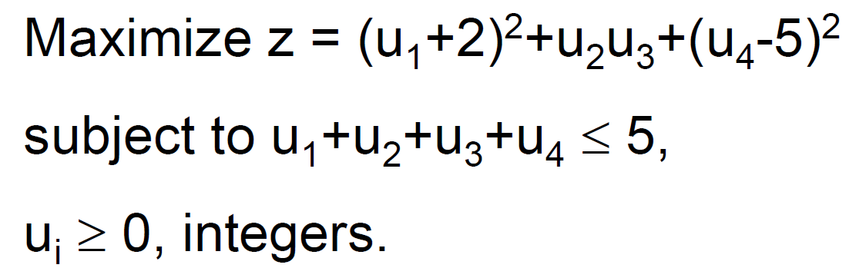
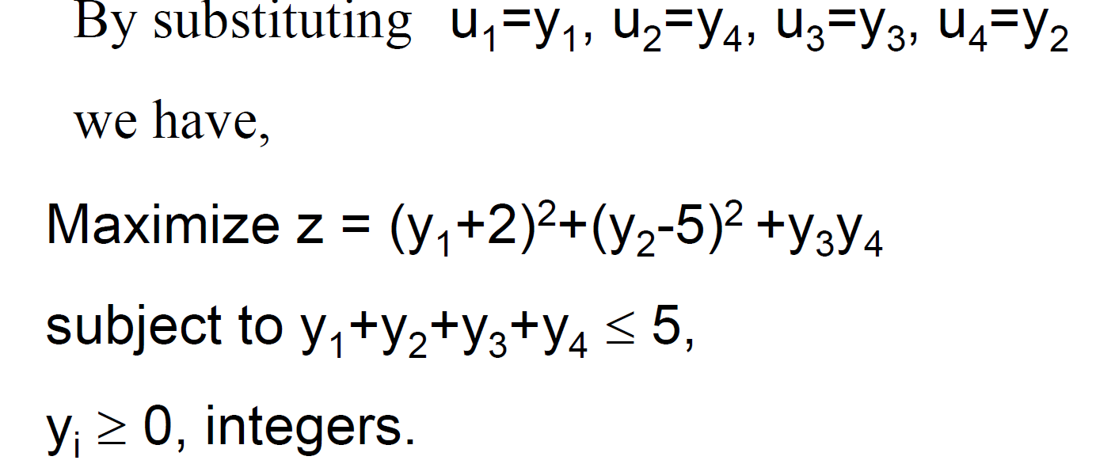
Solve the following problem by DP:

Slide 26
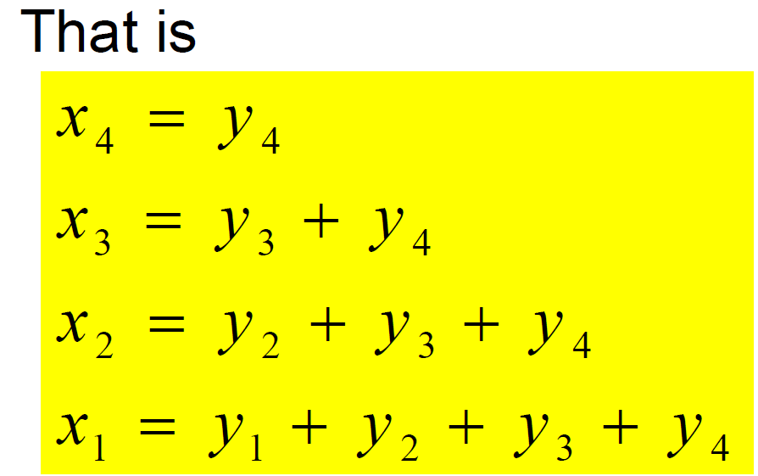
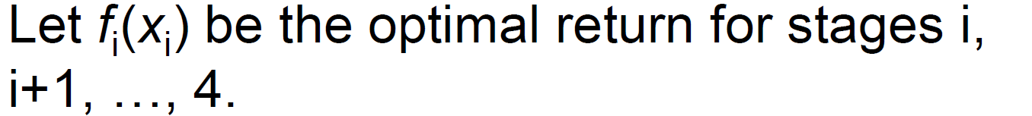

There are 4 stages to this problem. Let $x_{i}$, be the sum of the variables to be decided at stages i, i+1, …, 4.

Slide 27
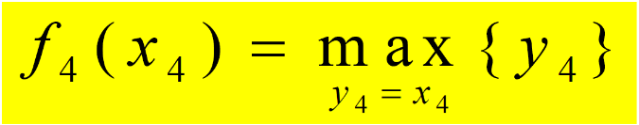
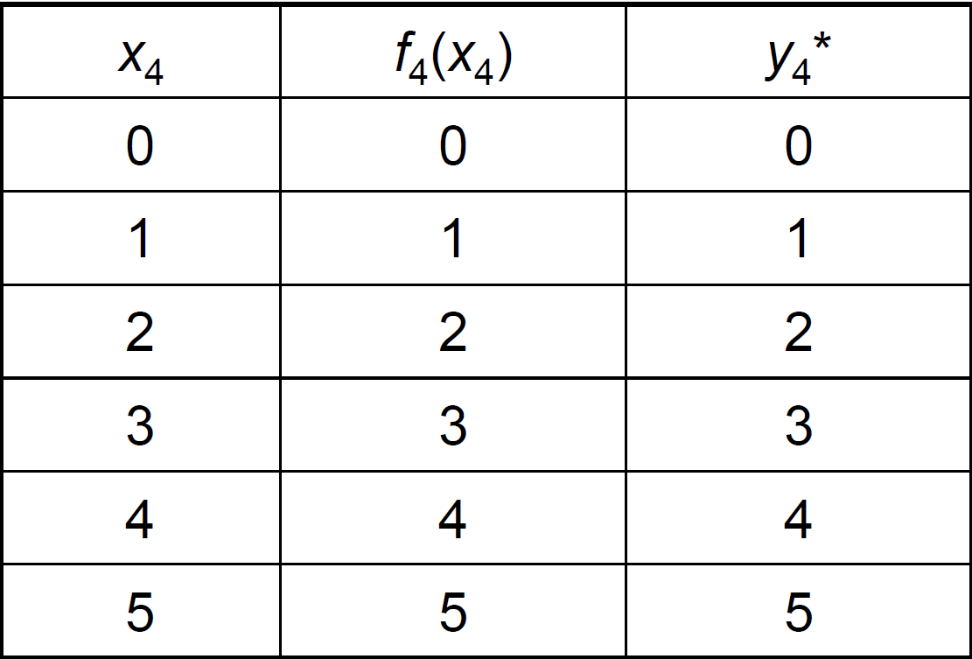
Stage 4:

Slide 28
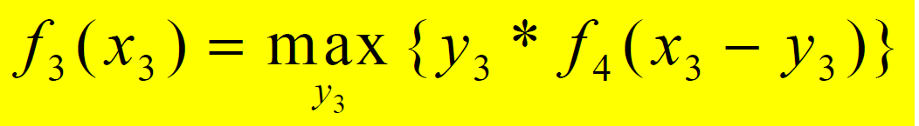
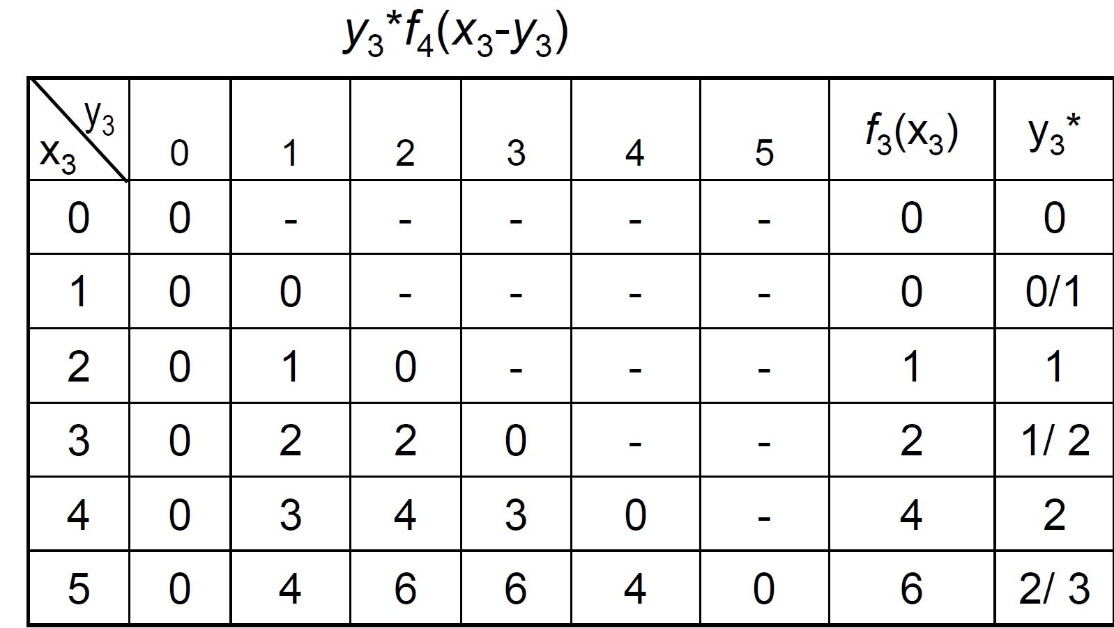
Stage 3:

Slide 29
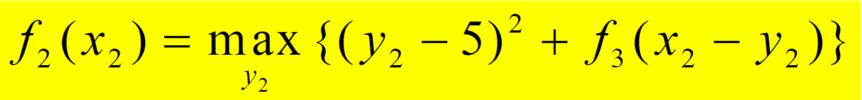
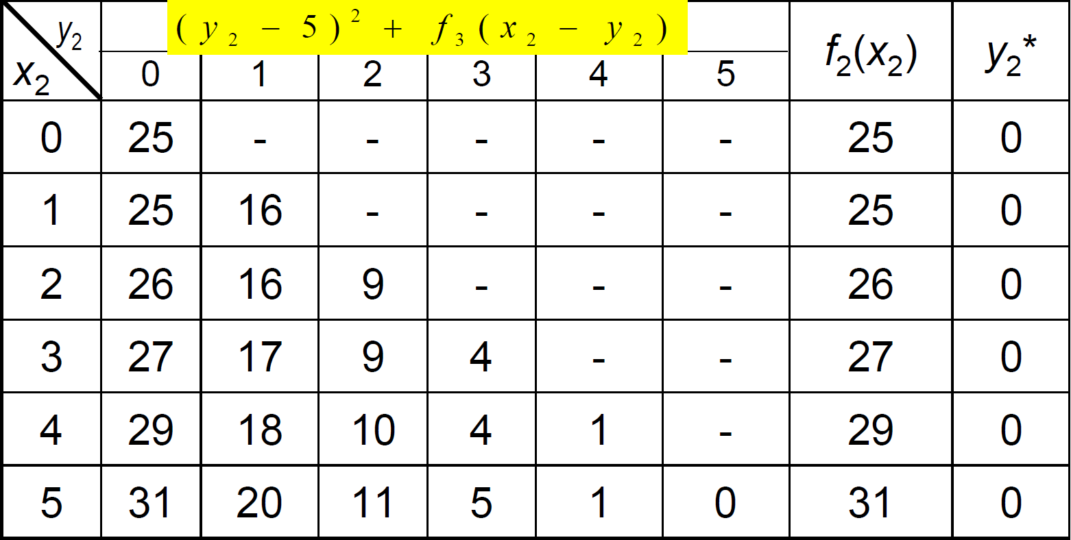
Stage 2:

Slide 30
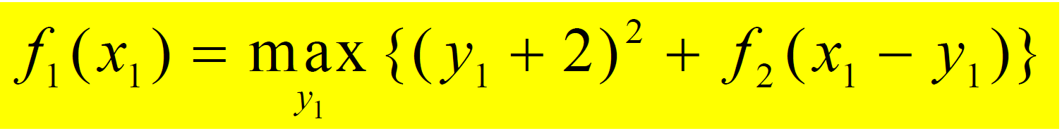
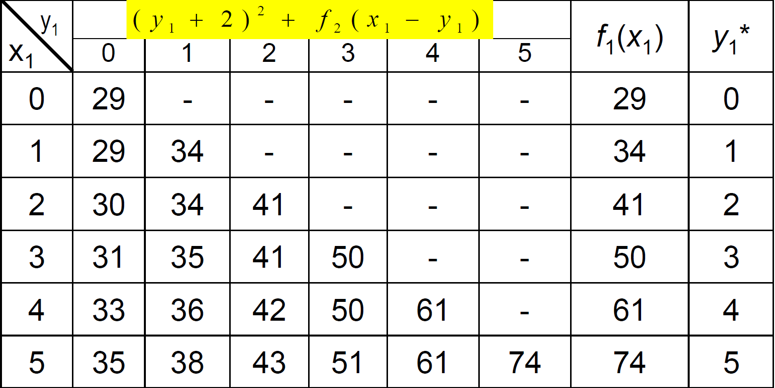
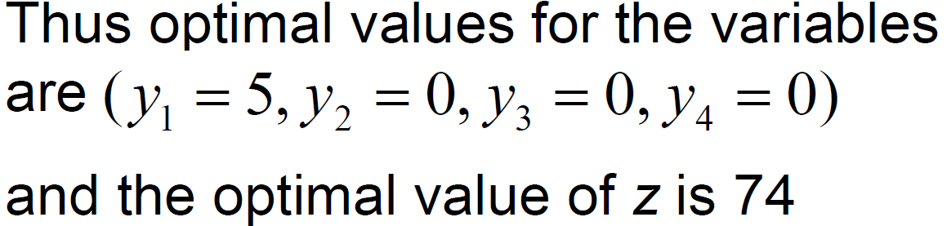
Stage 1:

Slide 31
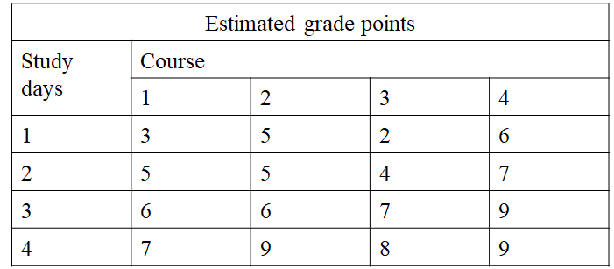
Example : (Resource Allocation Problem )
An M.Sc student has seven days remaining before END SEM examinations begin in her four courses, and she wants to allocate this study time as effectively as possible. She needs at least one day on each course, and she likes to concentrate on just one course each day, so she wants to allocate 1,2,3 or 4 days to each course. Having recently taken a Mathematical Programming course. She decides to use DP to make these allocations to maximize the total grade points to be obtained from the four courses. She estimates that the alternative allocations for each course would yield the number of grade points shown in the following table:
Solve the above problem by DP approach and list all the alternative optimum solutions.

Slide 32
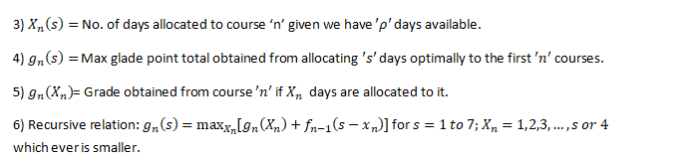
Each course represented as a stage
Each day represented as a state

Slide 33
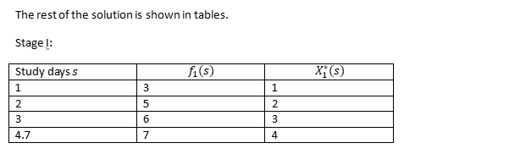

Slide 34
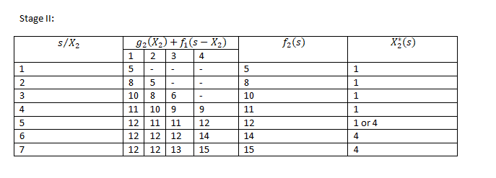

Slide 35
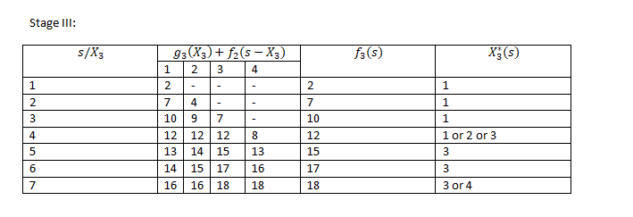

Slide 36
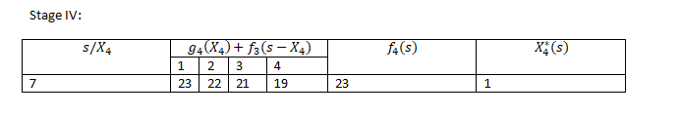
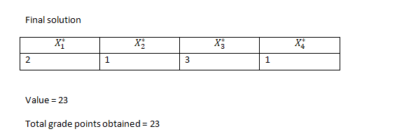

Slide 37
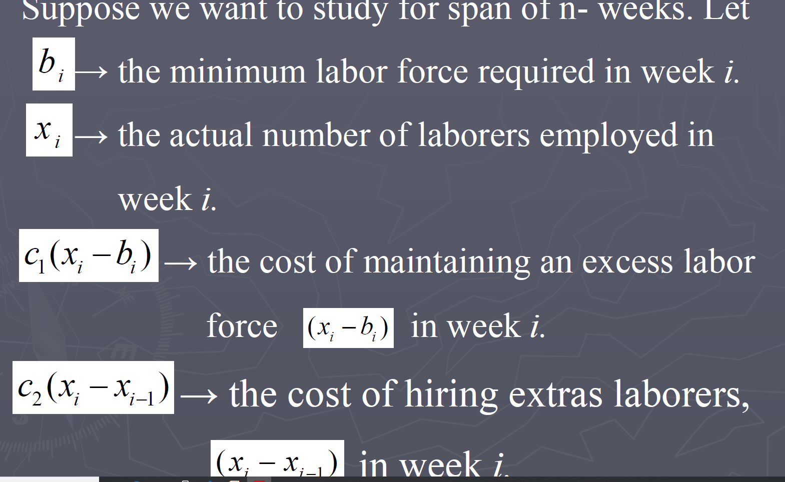
Work-Force Size Model
In some construction projects, hiring and firing are exercised to maintain a labor force that meets the needs of the project. Given that the activities of hiring and firing both incur additional costs, how should the labor force be maintained throughout the life of the project?.

Slide 38
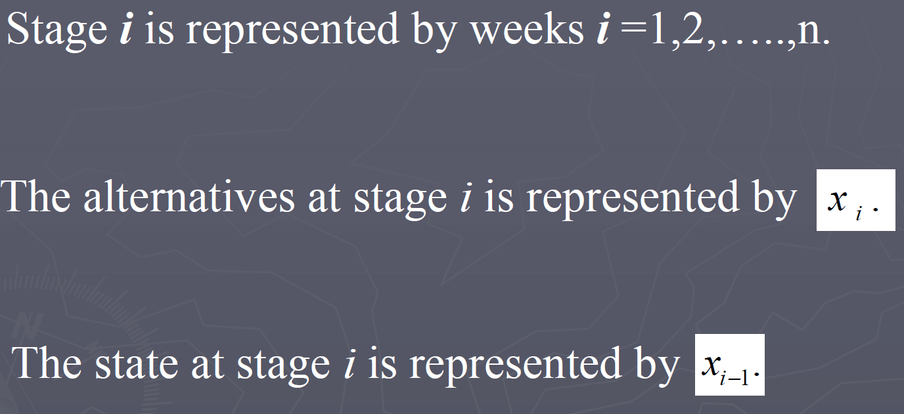
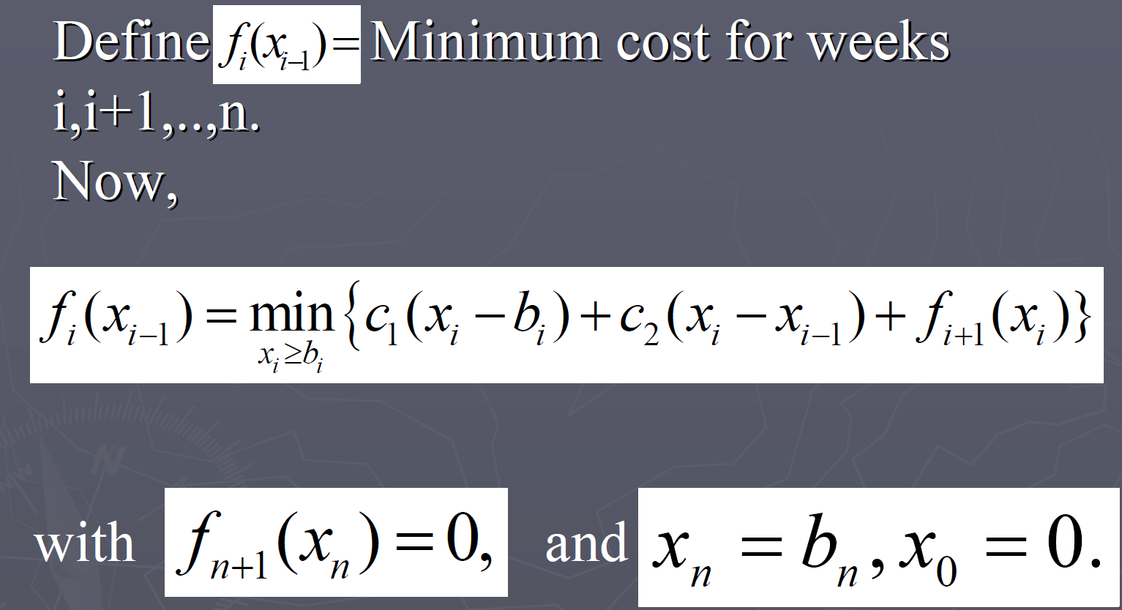

Slide 39
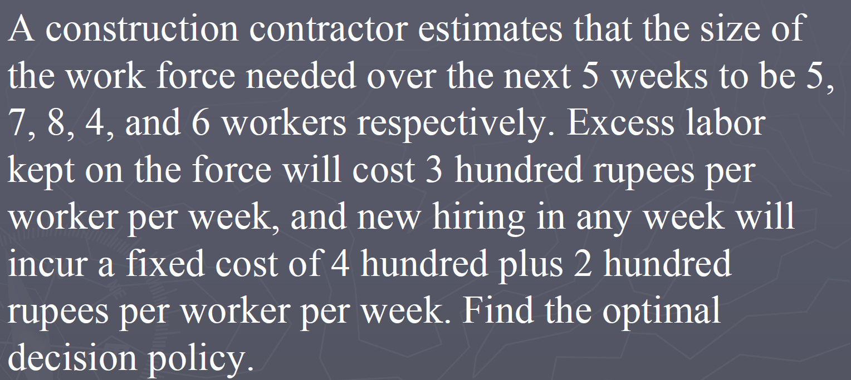
Example :

Slide 40
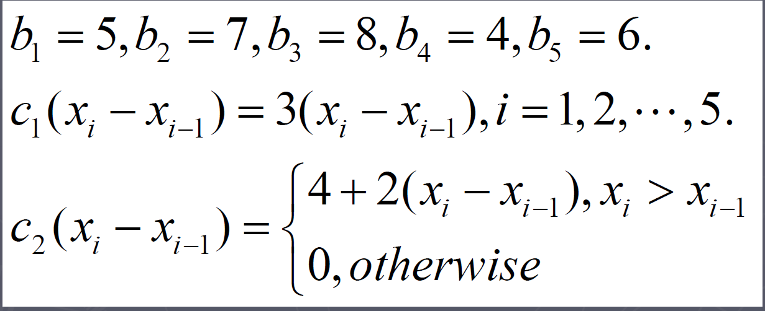
The data of the problem are summarized as

Slide 41
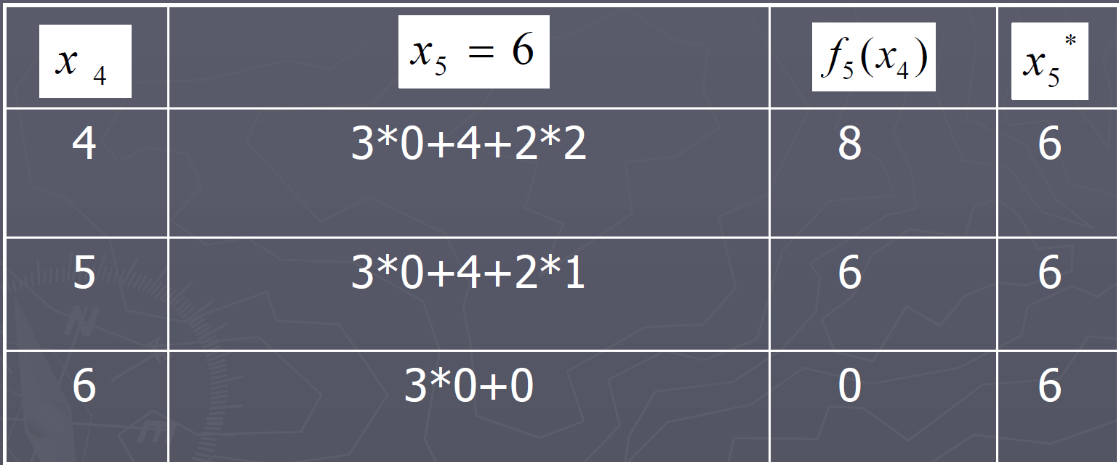
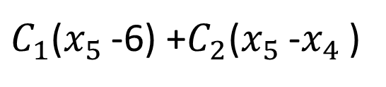
Stage 5:
$C_{1}$($x_{5 }$-6) +$C_{2}$($x_{5 }$-$x_{4 }$)

Slide 42
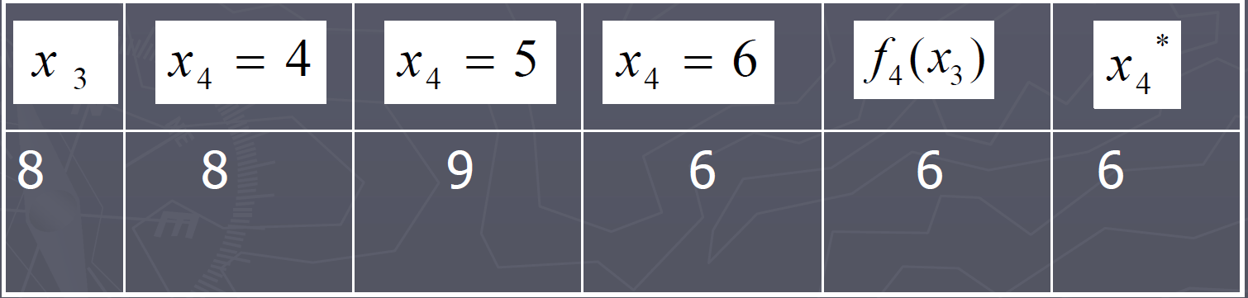



Stage 4:
$C_{1}$($x_{4 }$-4) +$C_{2}$($x_{4 }$-$x_{3 }$) + $f_{5}$($x_{4}$)
Stage 3:
$C_{1}$($x_{3 }$-8) +$C_{2}$($x_{3 }$-$x_{2 }$) + $f_{4}$($x_{3}$)

Slide 43




Stage 2 :
$C_{1}$($x_{2 }$-7) +$C_{2}$($x_{2 }$-$x_{1 }$) + $f_{3}$($x_{2}$)
Stage 1:
$C_{1}$($x_{1 }$-5) +$C_{2}$($x_{1 }$-$x_{0 }$) + $f_{2}$($x_{1}$)

Slide 44




The Optimum solution is determined as
For $x_{0 }$=0 $⇒$
The Total cost is $f_{1 }$(0)= Rs.3300

Slide 45

Solution of Linear Programming by Dynamic Approach
Any linear-programming problem with n decision variables and m constraints can be converted into an n-stage dynamic-programming problem with m state parameters. Set up a dynamic-programming formulation for the following linear programming problem:

Slide 46

Formulation as DP
Each activity j (j=1,2,…,n) may be regarded as a stage.
The level of activity ( ) 0 represents the alternatives at stage j, since is continuous.
Each stage possesses an infinite number of alternatives within the feasible space.
Assume 0.

Slide 47


Let be the states of the system at the stage j. i.e., the amounts of resources 1,2,…,m allocated to stage j,j+1,…,n.
Let be the optimum value of the objective function for stage j,j+1,…,n, given the states .

Slide 48


Slide 49

Use Dynamic programming to solve the Linear Programming Problem Example 1:

Slide 50
Solution:
The problem requires two interrelated decisions, therefore there are two stages in the equivalent dynamic programming problem.
Since there are two resources in this problems.
Therefore the states of the equivalent dynamic programming problem can be described by two variables. i.e, a state vector has two components only.

Slide 51


Let be the state of the system at stage j, j=1,2.
If is the optimal (maximum) value of the objective function for stage j=1,2,given the state then using Backward recursive equation.

Slide 52


Slide 53


Slide 54

in

Slide 55


Slide 56


Slide 57

Example 2:
B22B32

Slide 58


Slide 59


Slide 60


Slide 61
Optimal subdivision problem
The Dynamic Programming technique is used to solve optimal subdivision problems. For example, a positive quantity can be divided into some sub-quantities whose sum of cubes or squared sums or product may be maximum or minimum. In the same way, a known product can be split into a certain number of factors where the squared sum or the sum of factors may be minimum or maximum

Slide 62


Slide 63


Slide 64


Slide 66


Slide 67


Slide 68


Slide 69


Slide 70


Slide 71


